Slide 1
Defra Data Services Platform: OGC API - Features

Slide 2
INTRODUCTION

Slide 3
Introduction
Defra’s DSP makes data available as downloads and as web services
In keeping with Defra’s mission to make Open Data as widely available for re-use, Open Geospatial Consortium (OGC) standards have been adopted for spatial data
The DSP has adopted OGC API – Features (GeoJSON). An API based approach and a progression from Web Feature Services (XML)

Slide 4
Introduction
Aligning with the broader spatial community, and Government, the DSP provide OGC API – Features
Benefits of OGC API - Features have been demonstrated by spatial leaders, such as Ordnance Survey
Software vendors have updated their latest software stacks (including Esri) to support OGC API – Features

Slide 5
OVERVIEW

Slide 6
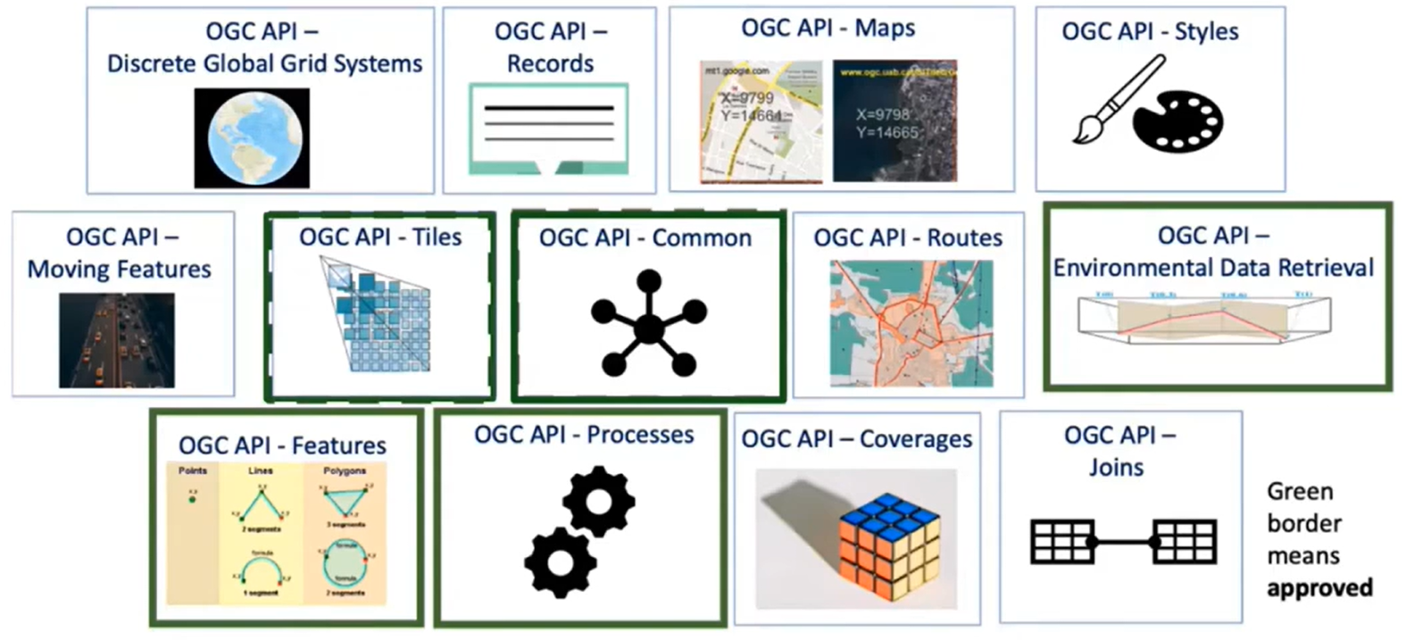
What are OGC API – Features?
The ‘Building Blocks for Location’
Part of the multi-part OGC API standard

Slide 7
What are OGC API – Features?
Standard that allows the capability to:
Create;
Modify; and
Query spatial data on the web
API based approach that gives flexibility on how data can be used and accessed
DSP data services have more capabilities that can be leveraged, above just sharing of data
Access to data at the Feature (Object) level, independent of the data store

Slide 8
OGC API – Features Overview

Slide 9



OGC API – Features Capabilities
Standard consistent with the architecture of the Web
Specifies discovery and query operations implemented using HTTP GET method
Discovery operations enable clients to interrogate the API and retrieve information for:
API Definition
Metadata
Feature collections

Slide 10
WHAT DOES THIS MEAN FOR ME?

Slide 11
What does this mean?
Consistent with non-spatial approaches, hugely broadening the user base
Supports Developers, Desktop GIS and Web Mapping Applications
Better performance and efficiencies to refine and query data using specified parameters
Compliant with Open Web Standards
…British National Grid implemented on the DSP, alongside WGS84 etc.

Slide 12
What does this mean?
Allows a Vendor Neutral approach, supporting Defra’s commitments on Open Data
Better supports more users to do more things with DSP data
Only need to add data users need for a current map extent
Provide building blocks to create, modify and query features on the Web
Users can tailor to meet their needs
Notes:
Cost considered benefit?
Do nothing of the defences. E&B benrfits. Value for water, navigation another mile etc. Nav.

Slide 13
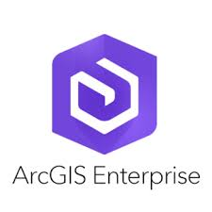

What does this mean?
Supported by Open and Proprietary Software and Applications
DSP Defra monitoring the platform to fine tune performance for these services, when released
Supported by a broad range of software, in addition to being accessed and used as any other API

Slide 14
HOW DO I USE OGC API FEATURES?

Slide 15
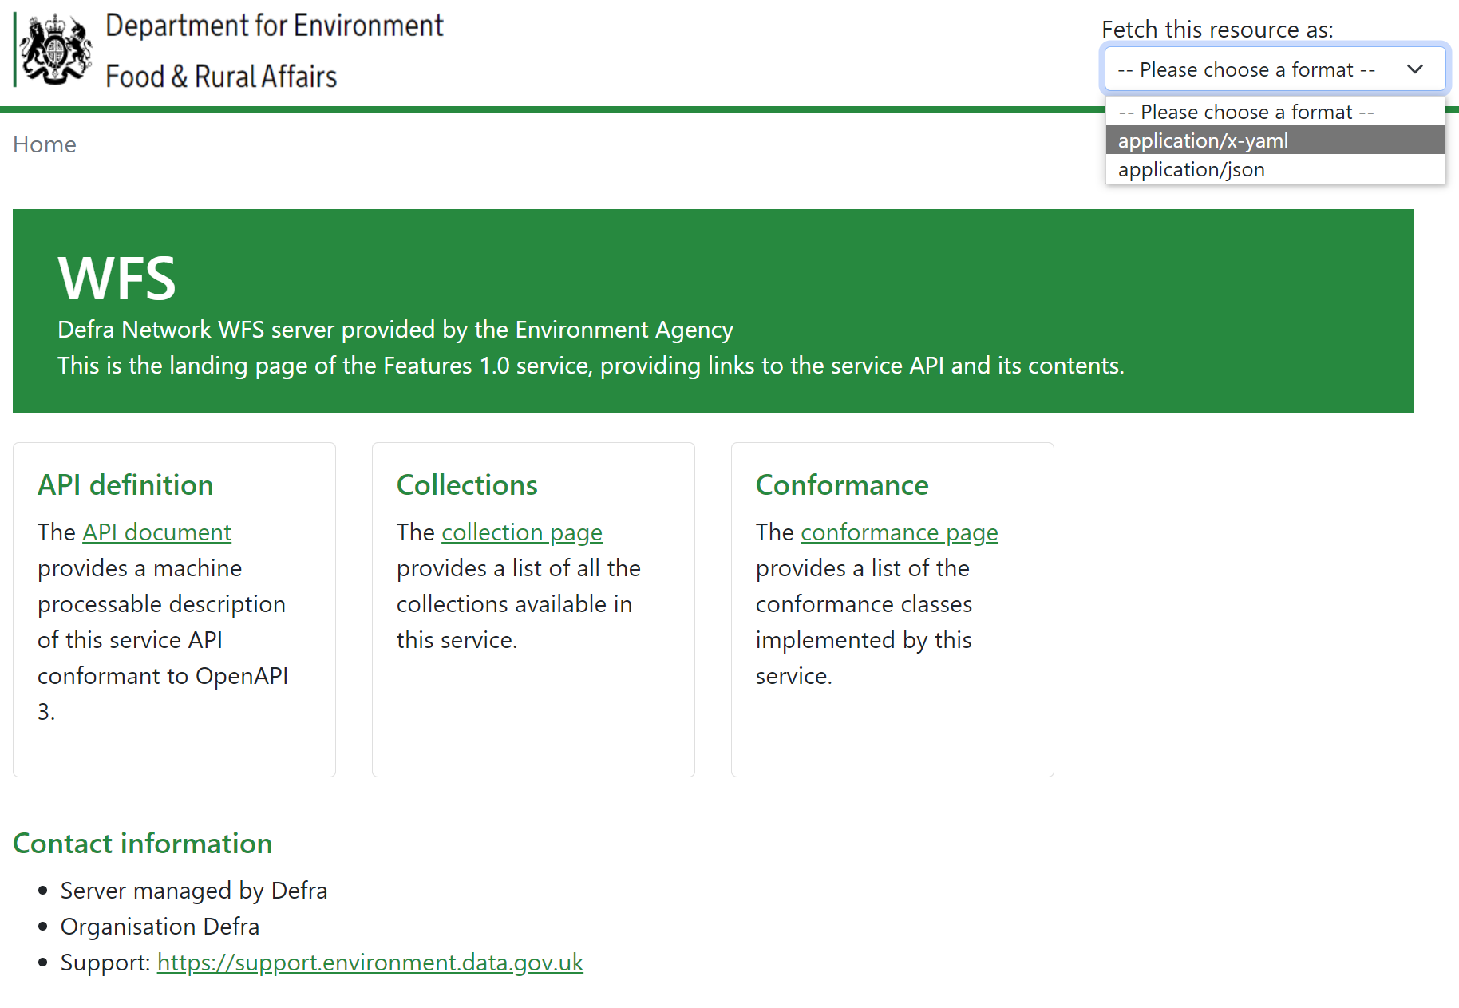
API Landing Page
Can be accessed via a Landing Page
Provides all the information a user needs on the Service

Slide 16
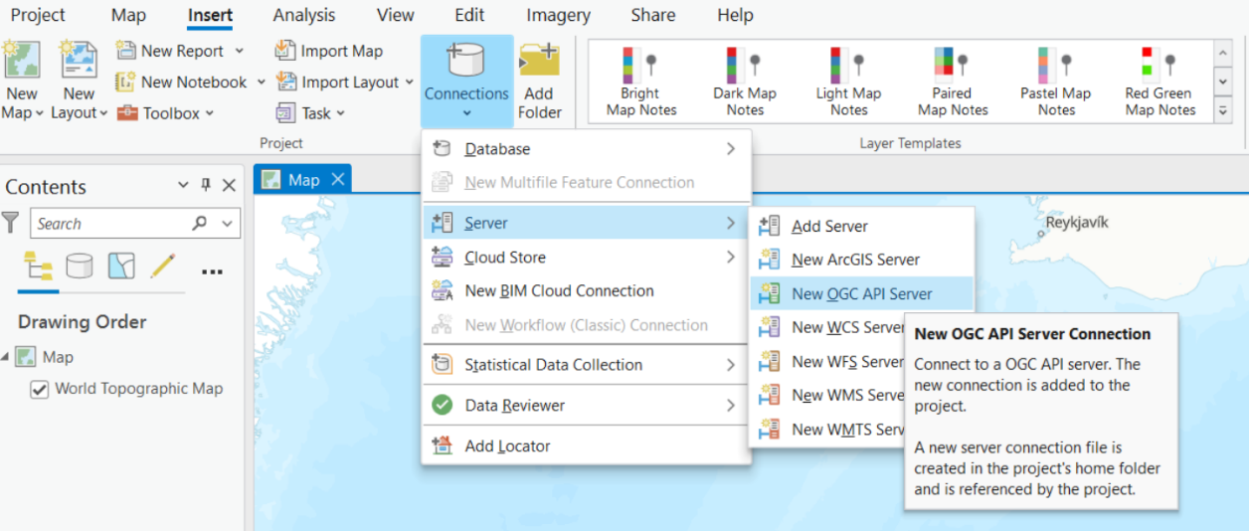
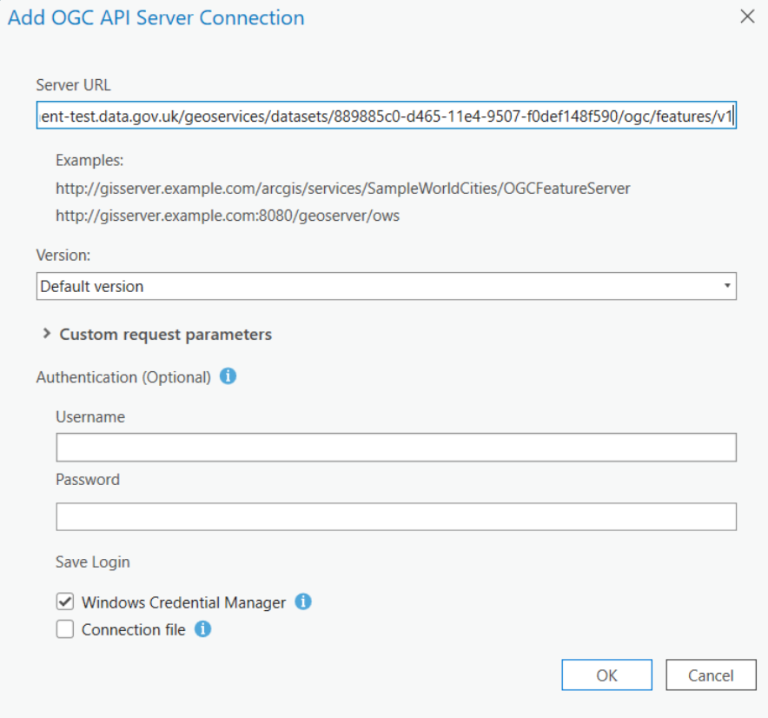
Using in ArcGIS Pro
Insert new Server Connection
Add OGC API Connection
Enter URL of the OGC API Server site

Slide 17
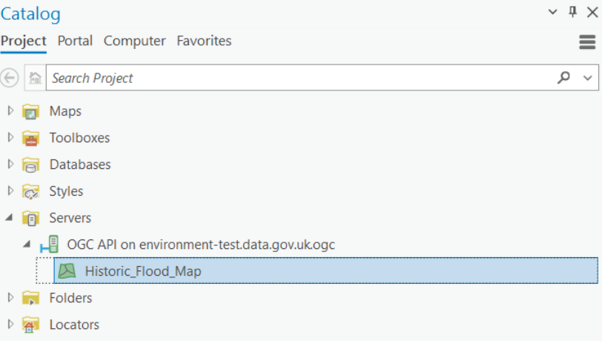
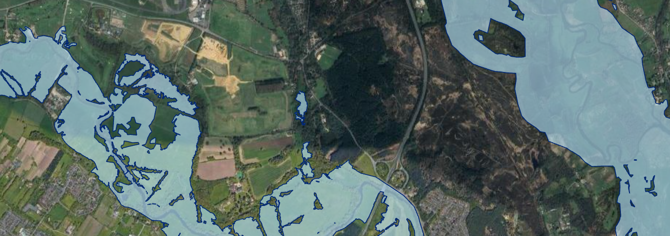
Using in ArcGIS Pro
OGC API connection (.ogc) has been created
Add to a map from Catalog pane by selecting the data layer

Slide 18
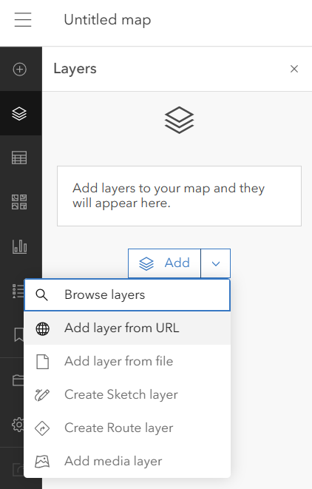
Using in ArcGIS Online and ArcGIS Enterprise (11.1 onwards)
Add Data Layer
Select Add layer from URL

Slide 19
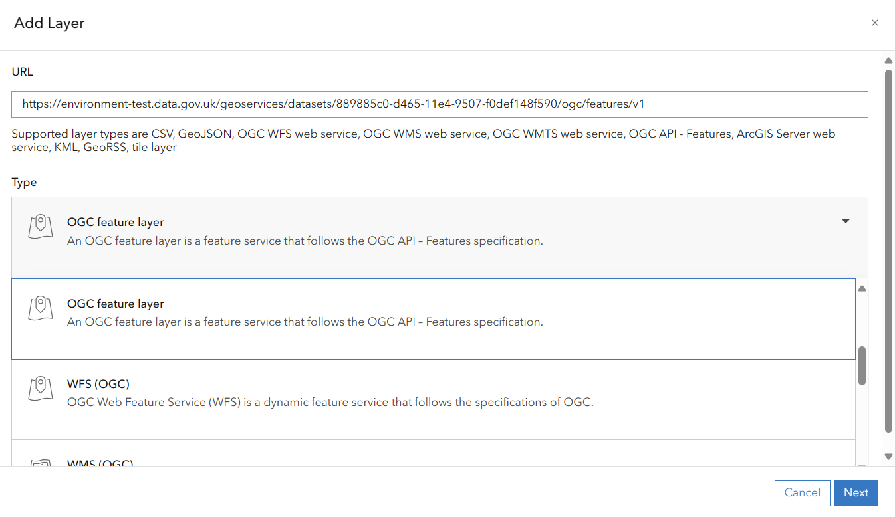
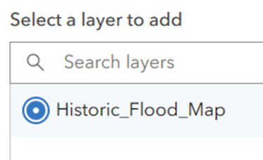
Using in ArcGIS Online and ArcGIS Enterprise (11.1 onwards)
Enter OGC API Features URL
Select OGC feature layer Type
Select layer(s) and add to map

Slide 20
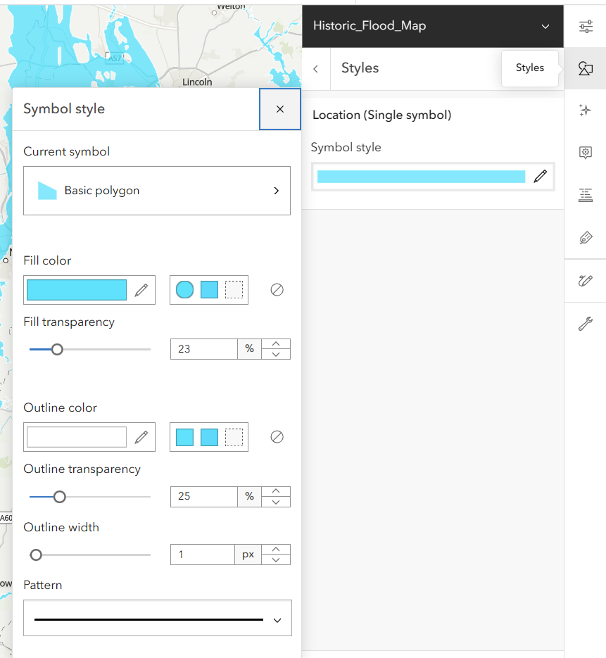
Using in ArcGIS Online and ArcGIS Enterprise (11.1 onwards)
Apply styling to Features
For example, by setting Symbol style

